Slide 1
Building Energy Consumption Classification
Dr. Lewe
Kunal Sharma
Georgia Tech

Slide 2
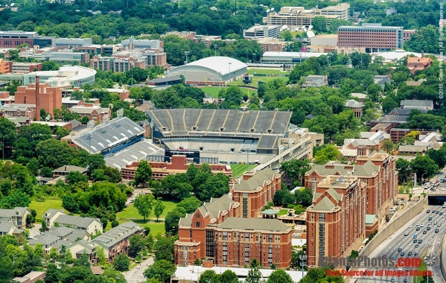

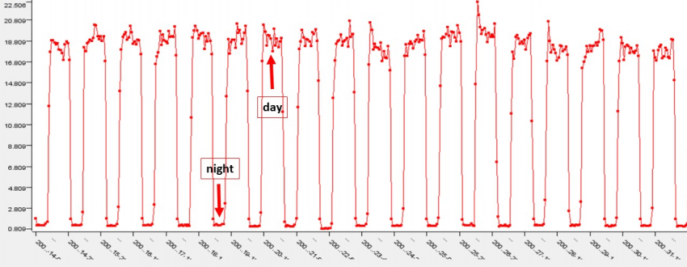
Data Collection
Energy Used by 134 Campus Buildings
Data Stored in Servers
Energy Data Used for Classification

Slide 3

ML Studies The Data
Machine Learning Model

Slide 4
Multiple ML Models
Decision Trees
Random Forest
KNN
SVM
Artificial Neural Networks
Naïve Bayes
Logistic Regression

Slide 5

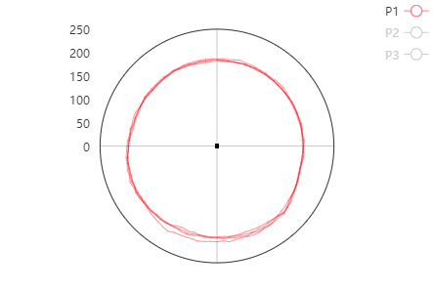
Model Classification
Cocentric!
Building #47 Energy Plot
People!
Cocentric!
People!
Random!
Cocentric!
Actual Classification: Cocentric
Cocentric!

Slide 6
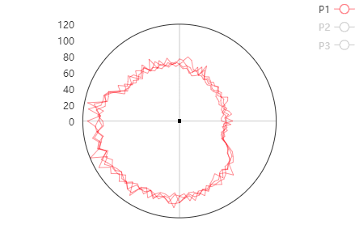
Model Classification
People!
Building #63 Energy Plot
Cocentric!
Random!
People!
Cocentric!
Cocentric!
Actual Classification: People
People!

Slide 7
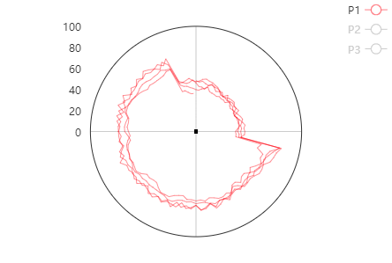
Model Classification
Scheduler!
Building #63 Energy Plot
Cocentric!
Scheduler!
Scheduler!
Cocentric!
Scheduler!
Actual Classification: Scheduler
People!

Slide 8
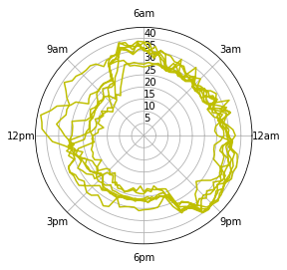
Model Classification
Scheduler!
Building #63 Energy Plot
Reverse!
Reverse!
Scheduler!
Cocentric!
Reverse!
Actual Classification: Reverse
Reverse!

Slide 9
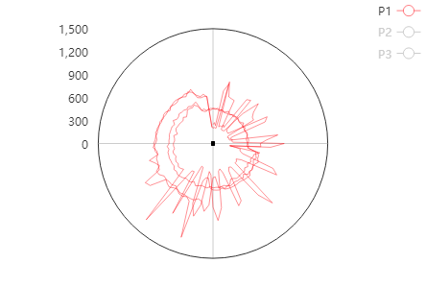
Model Classification
Random!
Building #63 Energy Plot
Random!
Reverse!
Random!
Random!
Reverse!
Actual Classification: Random
Reverse!

Slide 10
Fire Models with Low Accuracies
68%
86%
88%
43%
86%
38%
41%
Decision Trees
Random Forest
KNN
SVM
Artificial Neural Networks
Naïve Bayes
Logistic Regression

Slide 11

Weighted Voting-Based Classification
Building #63 Energy Plot
Random Forest
People!
Cocentric!
People!
KNN
Artificial Neural Networks
People!
Actual Classification: People

Slide 12

Voting has a Higher Accuracy
90%
86%
86%
88%
Voting
Artificial Neural Networks
Random Forest
KNN

Slide 13
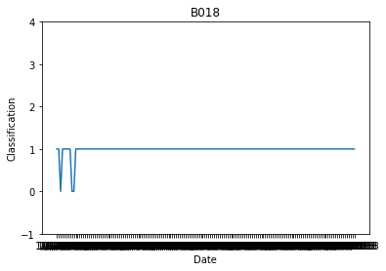
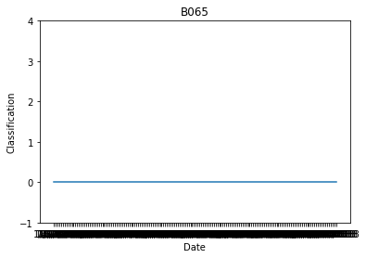








Voting Classification of Buildings – Normal
Jan Feb Mar Apr May Jun July Aug
Jan Feb Mar Apr May Jun July Aug
(2018)
(2018)

Slide 14
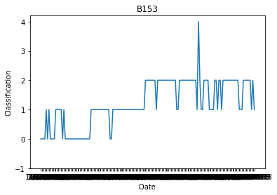
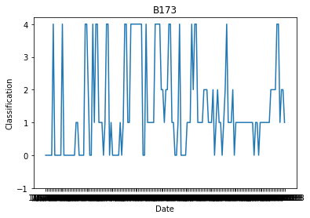


Voting Classification of Buildings – Abnormal
Jan Feb Mar Apr May Jun July Aug
Jan Feb Mar Apr May Jun July Aug
(2018)
(2018)

Slide 15
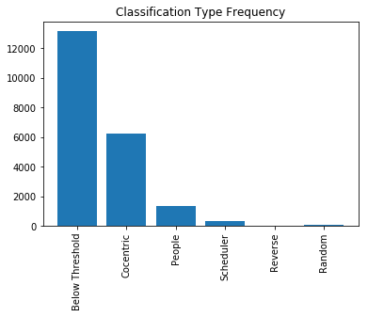
Classifying the Dataset
We can use the classification model to classify the energy consumption of 133 buildings over an 8 month period (Jan – Aug 2018).
Classification Type Frequency
Below Threshold (30kwh) | 13,157
Concentric | 6,259
People | 1,333
Scheduler | 341
Reverse | 5
Random | 77
Total | 21,172

Slide 16

Case Study: B051D, B173
Building B051D is an example of a building that is consistently classified as 0 (Concentric).
In contrast, building B173 continuously changes classification throughout the 8 months.

Slide 17

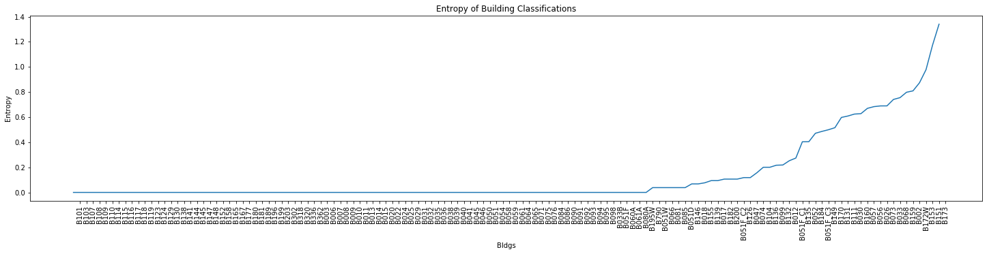
Using Entropy to Rank Building Volatility
Entropy can calculate how mixed a set is. We can calculate the entropy of buildings and rank them.
Entropy Equation

Slide 18

Using Entropy to Visualize Volatility
We can visualize the entropy of buildings overtime.
The heatmap on the right allows us to quickly identify buildings with the most volatility in energy consumption behavior.

